Slide 1
SQL

Slide 2

Database
Database is collection of data in a format that can be easily accessed (Digital)
A software application used to manage our DB is called DBMS (Database Management System)

Slide 3


Types of Databases
Relational
Data stored in tables
Non-relational (NoSQL)
data not stored in tables
** We use SQL to work with relational DBMS

Slide 4
What is SQL?
Structured Query Language
SQL is a programming language used to interact with relational databases.
It is used to perform CRUD operations : Create
Read Update Delete

Slide 5
Database Structure
Database
Table 1
Table 2
Data
Data

Slide 6
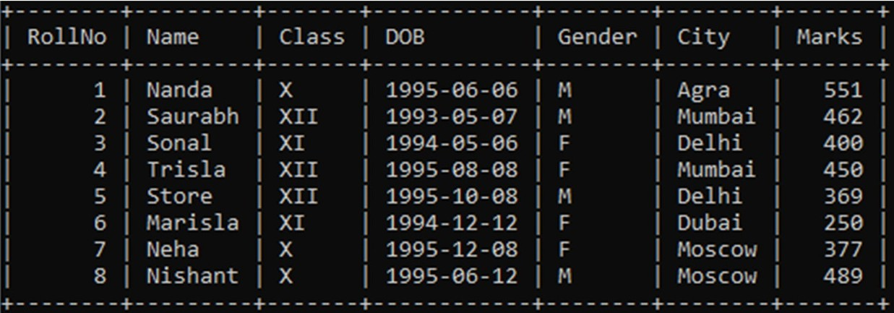
What is a table?
Student table

Slide 7
Creating our First Database
Our first SQL Query
CREATE DATABASE db_name;
DROP DATABASE db_name;

Slide 8
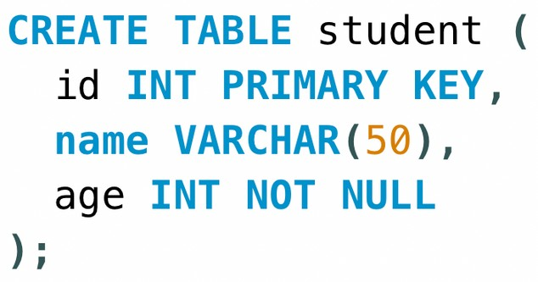
Creating our First Table
USE db_name;
CREATE TABLE table_name ( column_name1 datatype constraint, column_name2 datatype constraint, column_name2 datatype constraint
);

Slide 9
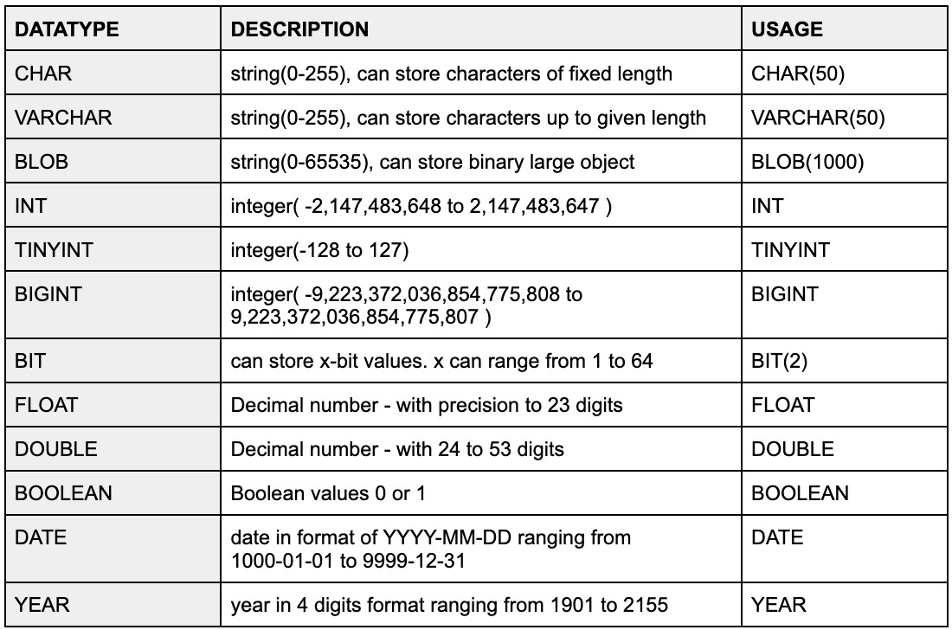
SQL Datatypes
They define the type of values that can be stored in a column

Slide 10
SQL Datatypes
Signed & Unsigned
TINYINT UNSIGNED (0 to 255)
TINYINT (-128 to 127)

Slide 11
Types of SQL Commands
DDL (Data Definition Language) : create, alter, rename, truncate & drop
DQL (Data Query Language) : select
DML (Data Manipulation Language) : select, insert, update & delete
DCL (Data Control Language) : grant & revoke permission to users
TCL (Transaction Control Language) : start transaction, commit, rollback etc.

Slide 12
Database related Queries
CREATE DATABASE db_name;
CREATE DATABASE IF NOT EXISTS db_name;
DROP DATABASE db_name;
DROP DATABASE IF EXISTS db_name;
SHOW DATABASES;
SHOW TABLES;

Slide 13
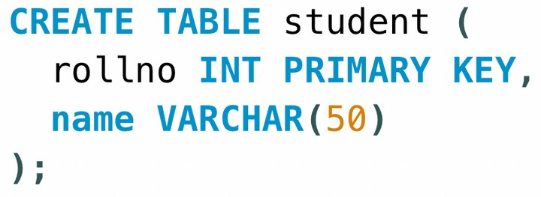
Table related Queries
Create
CREATE TABLE table_name ( column_name1 datatype constraint, column_name2 datatype constraint,
);

Slide 14
Table related Queries
Select & View ALL columns
SELECT * FROM table_name;

Slide 15
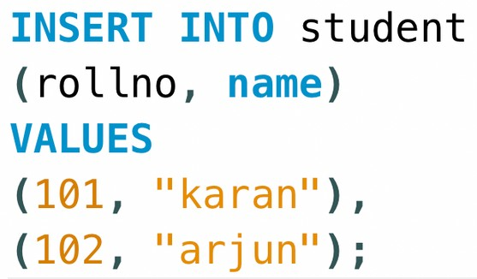
Table related Queries
Insert
INSERT INTO table_name (colname1, colname2); VALUES
(col1_v1, col2_v1), (col1_v2, col2_v2);

Slide 16

Keys
Primary Key
It is a column (or set of columns) in a table that uniquely identifies each row. (a unique id) There is only 1 PK & it should be NOT null.
Foreign Key
A foreign key is a column (or set of columns) in a table that refers to the primary key in another table.
There can be multiple FKs.
FKs can have duplicate & null values.

Slide 17
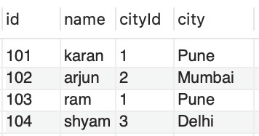
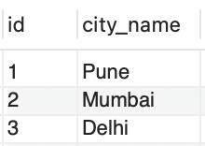
Keys
table1 - Student
table2 - City

Slide 18



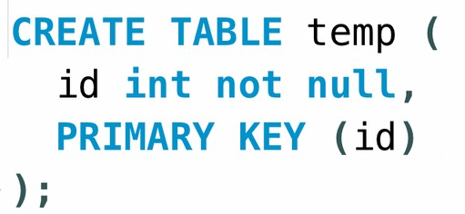
Constraints
SQL constraints are used to specify rules for data in a table.
NOT NULL columns cannot have a null value
UNIQUE
all values in column are different
PRIMARY KEY
makes a column unique & not null but used only for one

Slide 19
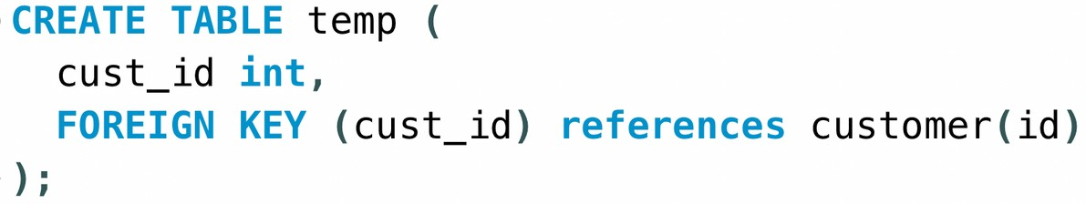
Constraints
FOREIGN KEY prevent actions that would destroy links between tables
DEFAULT
sets the default value of a column

Slide 20
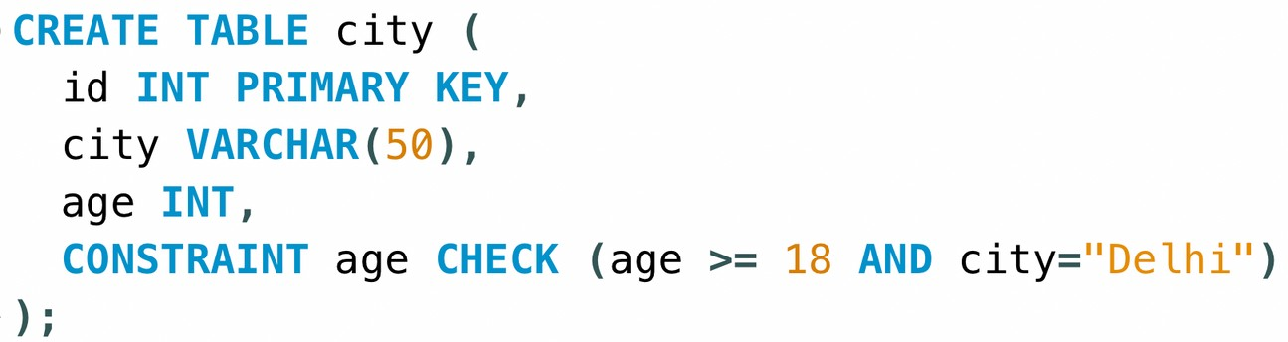
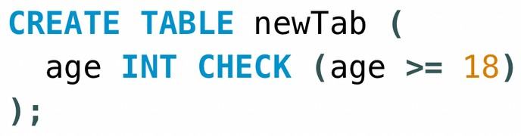
Constraints
CHECK it can limit the values allowed in a column

Slide 21
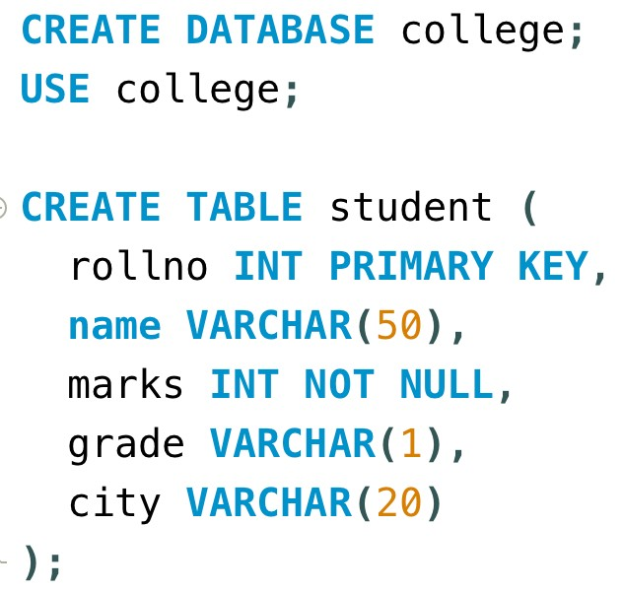
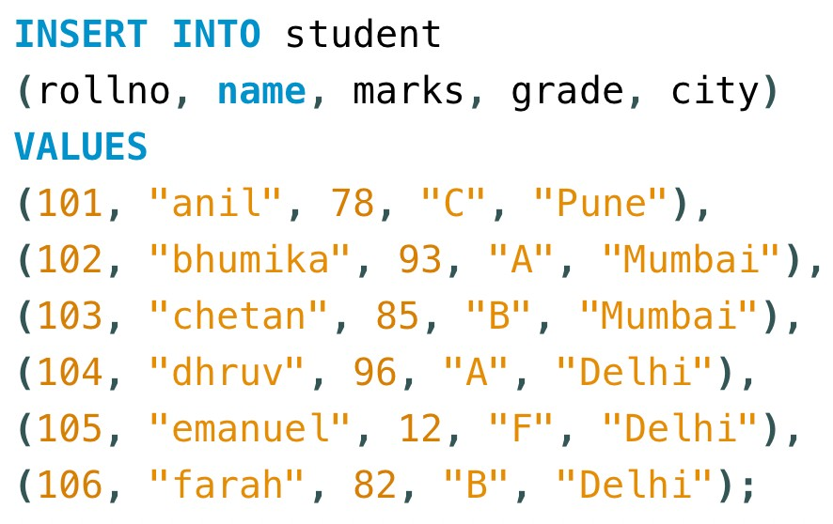
Create this sample table
Insert this data

Slide 22
Select in Detail
used to select any data from the database
Basic Syntax
SELECT col1, col2 FROM table_name;
To Select ALL
SELECT * FROM table_name;

Slide 23

Where Clause
To define some conditions
SELECT col1, col2 FROM table_name
WHERE conditions;

Slide 24
Where Clause
Using Operators in WHERE
Arithmetic Operators : +(addition) , -(subtraction), *(multiplication), /(division), %(modulus)
Comparison Operators : = (equal to), != (not equal to), > , >=, <, <= Logical Operators : AND, OR , NOT, IN, BETWEEN, ALL, LIKE, ANY
Bitwise Operators : & (Bitwise AND), | (Bitwise OR)

Slide 25
Operators
AND (to check for both conditions to be true)
OR (to check for one of the conditions to be true)

Slide 26
Operators
Between (selects for a given range)
In (matches any value in the list)
NOT (to negate the given condition)

Slide 27
Limit Clause
Sets an upper limit on number of (tuples)rows to be returned
SELECT col1, col2 FROM table_name
LIMIT number;

Slide 28

Order By Clause
To sort in ascending (ASC) or descending order (DESC)
SELECT col1, col2 FROM table_name
ORDER BY col_name(s) ASC;

Slide 29


Aggregate Functions
Aggregare functions perform a calculation on a set of values, and return a single value.
COUNT( ) MAX( )
MIN( )
SUM( )
AVG( )
Get Maximum Marks
Get Average marks

Slide 30
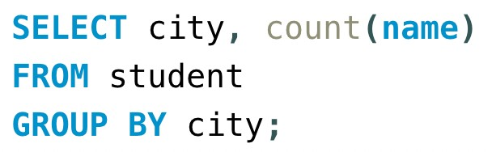
Group By Clause
Groups rows that have the same values into summary rows.
It collects data from multiple records and groups the result by one or more column.
*Generally we use group by with some aggregation function.
Count number of students in each city

Slide 31
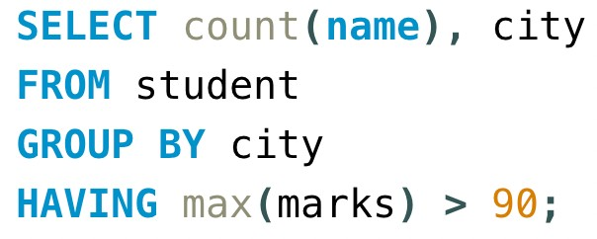
Having Clause
Similar to Where i.e. applies some condition on rows. Used when we want to apply any condition after grouping.
Count number of students in each city where max marks cross 90.

Slide 32
General Order
SELECT column(s) FROM table_name WHERE condition GROUP BY column(s) HAVING condition
ORDER BY column(s) ASC;

Slide 33
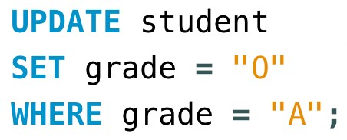
Table related Queries
Update (to update existing rows)
UPDATE table_name
SET col1 = val1, col2 = val2
WHERE condition;

Slide 34

Table related Queries
Delete (to delete existing rows)
DELETE FROM table_name
WHERE condition;

Slide 35
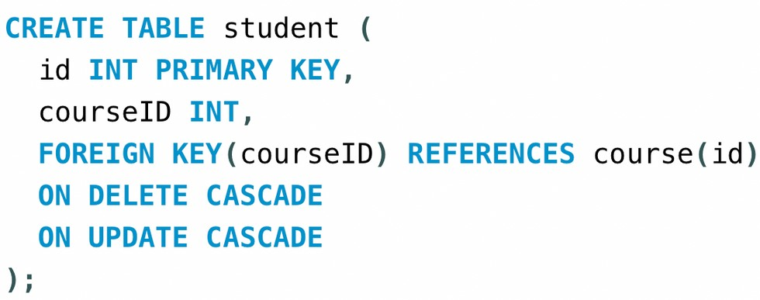
Cascading for FK
On Delete Cascade
When we create a foreign key using this option, it deletes the referencing rows in the child table when the referenced row is deleted in the parent table which has a primary key.
On Update Cascade
When we create a foreign key using UPDATE CASCADE the referencing rows are updated in the child table when the referenced row is updated in the parent table which has a primary key.

Slide 36
Table related Queries
Alter (to change the schema)
ADD Column
ALTER TABLE table_name
ADD COLUMN column_name datatype constraint;
DROP Column
ALTER TABLE table_name
DROP COLUMN column_name;
RENAME Table
ALTER TABLE table_name
RENAME TO new_table_name;

Slide 37
Table related Queries
CHANGE Column (rename)
ALTER TABLE table_name
CHANGE COLUMN old_name new_name new_datatype new_constraint;
MODIFY Column (modify datatype/ constraint)
ALTER TABLE table_name
MODIFY col_name new_datatype new_constraint;

Slide 38

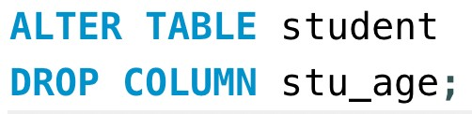



ADD Column
DROP Column
MODIFY Column
RENAME Table
CHANGE Column (rename)

Slide 39
Table related Queries
Truncate (to delete table's data)
TRUNCATE TABLE table_name ;

Slide 40
Joins in SQL
Join is used to combine rows from two or more tables, based on a related column between them.

Slide 41




Types of Joins
Inner Join
Left Join
Right Join
Full Join
Outer Joins

Slide 42
Inner Join
Returns records that have matching values in both tables
Syntax
SELECT column(s) FROM tableA INNER JOIN tableB
ON tableA.col_name = tableB.col_name;

Slide 43
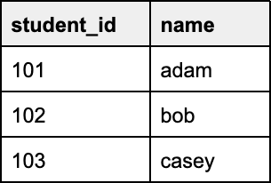
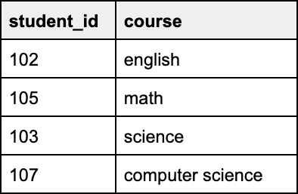
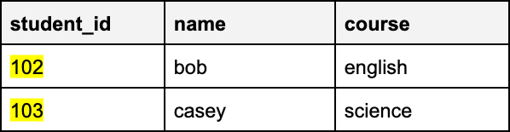
Inner Join
Example
SELECT *
FROM student
INNER JOIN course
ON student.student_id = course.student_id;
student
course
Result

Slide 44
Left Join
Returns all records from the left table, and the matched records from the right table
Syntax
SELECT column(s) FROM tableA LEFT JOIN tableB
ON tableA.col_name = tableB.col_name;

Slide 45
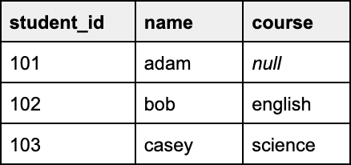
Left Join
Example
SELECT *
FROM student as s
LEFT JOIN course as c
ON s.student_id = c.student_id;
student
course
Result

Slide 46
Right Join
Returns all records from the right table, and the matched records from the left table
Syntax
SELECT column(s) FROM tableA RIGHT JOIN tableB
ON tableA.col_name = tableB.col_name;

Slide 47
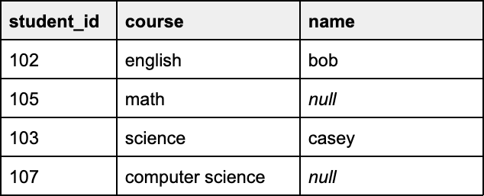
Right Join
Example
SELECT *
FROM student as s
RIGHT JOIN course as c
ON s.student_id = c.student_id;
student
course
Result

Slide 48
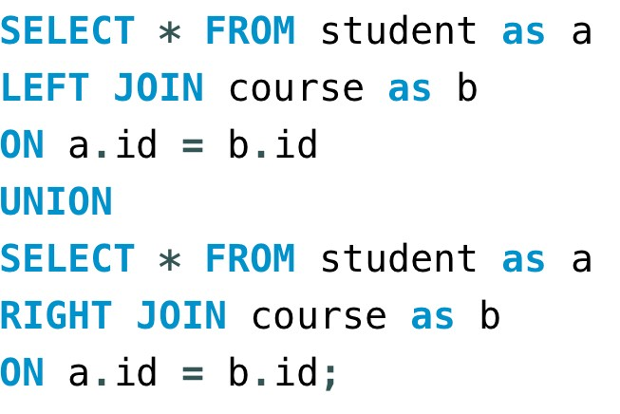
Full Join
Returns all records when there is a match in either left or right table
Syntax in MySQL
LEFT JOIN UNION RIGHT JOIN

Slide 49
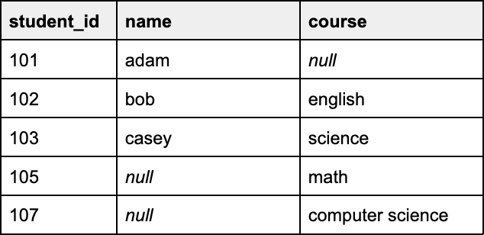
Full Join
Example
student
course
Result

Slide 50



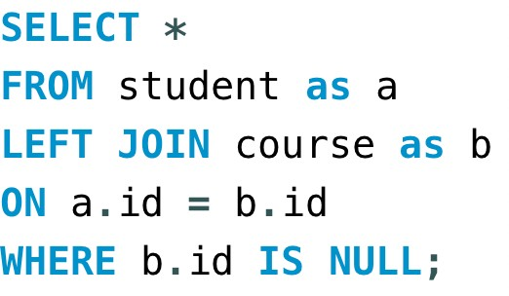
Think & Ans
Qs: Write SQL commands to display the right exclusive join :
Left Exclusive Join
Right Exclusive Join

Slide 51
Self Join
It is a regular join but the table is joined with itself.
Syntax
SELECT column(s) FROM table as a JOIN table as b
ON a.col_name = b.col_name;

Slide 52
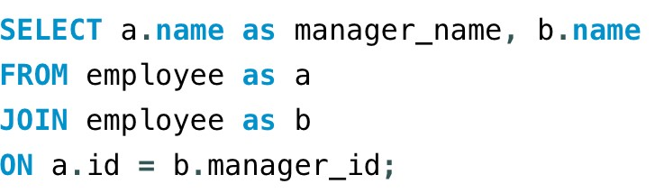
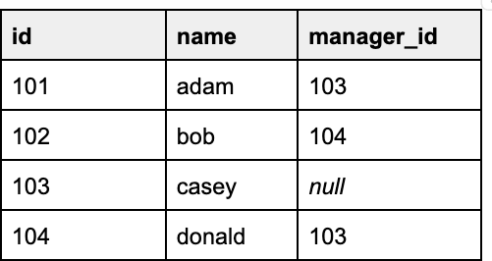
Self Join
Example
Employee
Result

Slide 53
Union
It is used to combine the result-set of two or more SELECT statements. Gives UNIQUE records.
To use it :
every SELECT should have same no. of columns columns must have similar data types
columns in every SELECT should be in same order
Syntax
SELECT column(s) FROM tableA
UNION
SELECT column(s) FROM tableB

Slide 54

SQL Sub Queries
A Subquery or Inner query or a Nested query is a query within another SQL query.
It involves 2 select statements.
Query
Syntax
SELECT column(s)
FROM table_name
WHERE col_name operator ( subquery );
Sub Query

Slide 55
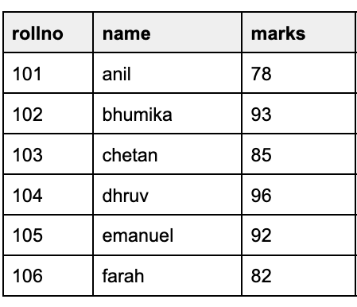
SQL Sub Queries
Example
Get names of all students who scored more than class average.
Step 1. Find the avg of class
Step 2. Find the names of students with marks > avg

Slide 56
SQL Sub Queries
Example
Find the names of all students with even roll numbers.
Step 1. Find the even roll numbers
Step 2. Find the names of students with even roll no

Slide 57
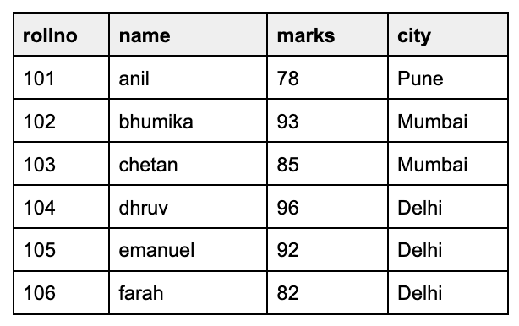
SQL Sub Queries
Example with FROM
Find the max marks from the students of Delhi
Step 1. Find the students of Mumbai
Step 2. Find their max marks using the sublist in step 1

Slide 58
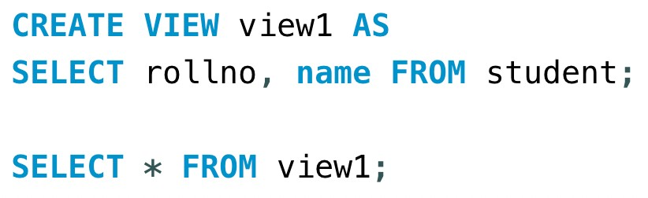
MySQL Views
A view is a virtual table based on the result-set of an SQL statement.
*A view always shows up-to-date data. The database engine recreates the view, every time a user queries it.

